Slide 1
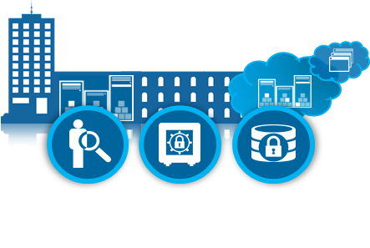
IBM Mobile Security solutions
Enterprise Applications
and Cloud Services
Personal and Consumer
Enterprise
Security Intelligence
DATA
Identity & Access
Application Security
Content Security
Device Security
Identity, Fraud, and Data Protection
Device Security | Content Security | Application Security | Identity & Access
Provision, manage and secure Corporate and BYOD devices | Secure enterprise content sharing and segregate enterprise and personal data | Develop secure, vulnerability free, hardened and risk aware applications | Secure access and transactions for customers, partners and employees
Security Intelligence
A unified architecture for integrating mobile security information and event management (SIEM), log management, anomaly detection, and configuration and vulnerability management
IBM MobileFirst Protect (MaaS360)
IBM Security AppScan, Arxan Application Protection, IBM Trusteer Mobile SDK
IBM Security Access Manager for Mobile, IBM Trusteer Pinpoint
Airwatch, MobileIron, Good, Citrix, Microsoft, Mocana
HP Fortify, Veracode, Proguard
CA, Oracle, RSA
IBM QRadar Security Intelligence Platform
Notes:
IBM Managed Security Services
IBM Smart and Embedded Device Security
Mobile Application Dynamic Assessment
Mobile Application Source Code Review
IBM Hosted Application Security Management
Secure SDLC with Threat Modeling
Identity and Access Management Assessment and Strategy
IBM Secure Web Gateway Management
IBM Penetration Testing
IBM Application Security Assessment for Web Apps

Slide 2
IBM Mobile Security: Powerful Security Solution Combinations Today
Mobile Threat Management that can protect an organization from the various mobile threats that are hard to recognize ahead of time
Detecting Multi-factor Risks and Events, such as insider fraud, that can’t be determined by any single system or data set
Mobile Identity Access Controls that integrate your identity and context into dynamic decisions on apps, content, and infrastructure access
Unified Endpoint Management that spans the broadest OS and device set in the industry from servers, PCs, Macs, tablets, smartphones, embedded and hardened devices, POS, and soon IoT
Integrated Application Security that can be instrumented into mobile applications at the time of compile or app catalog distribution

Slide 3
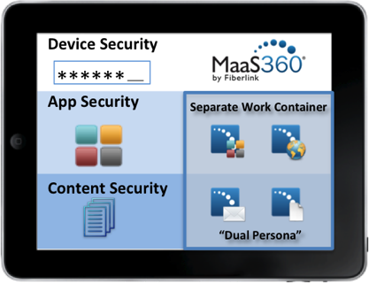
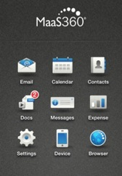
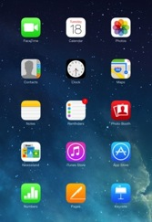
How does MobileFirst Protect work?
Suite of Productivity Apps
Enterprise App Store
Secure Mail
Secure Browser
Enterprise Gateway
Content Sync and Share
Document Editor
Separate Work / Personal Mobility
Enterprise users and assets secured with MaaS360 Trusted Workplace™ Technology
Notes:
Our MobileFirst Protect secure container solutions deliver a Dual Persona approach to separate personal and enterprise data in this BYOD era. It provides a Trusted WorkPlace container for a complete mobile security and productivity solution with strong data leak prevention (DLP) and consistent and seamless workflows.
It is the only comprehensive cloud-based solution for iOS, Android and Windows Phone that enables employees to securely access corporate data while preserving the mobile experience on their personal devices.
It is available as a standalone solution without even needing to enroll devices in MDM. Ideal for BYOD programs or working with contractors, consultants and vendors, you can securely share and collaborate without needing to manage and control these devices.
Our MobileFirst Protect secure container solutions keep everything your users need for work in one secure container. They can manage all their emails, contacts, calendars, apps, documents and Web browsing from one dedicated workspace on their mobile devices, no matter what devices they’re using or who owns them.
With policies to control the movement of data, you can restrict sharing by users, forwarding of attachments, and copying and pasting. Devices that are lost, stolen or compromised can be selectively wiped to remove the secure container and everything in it.
It uses a dual persona approach to separate work from play so you can put controls in place to manage this secure container that won't affect the rest of the device.
MobileFirst Protect provides IT teams a wide range of mobile security options to separate corporate and personal information across different categories of users, devices, content, and apps, all within the context of their business. This gives our customers the flexibility to offer tiered or layered mobile security to address their varied end user needs and IT security requirements, from MDM essentials to stricter lockdown capabilities of corporate data for specific users.
For businesses that need stringent security policy and compliance controls, such as those in the highly regulated healthcare and financial services industries, containerization can be especially helpful in making the BYOD experience more palatable for users.
With MobileFirst Protect, organizations can phase in BYOD and “right size” their mobile security investments for different classes of users, departments, geographies, devices and applications, and apply the technology approach that best meets the need of those use cases, all from a unified platform.

Slide 4
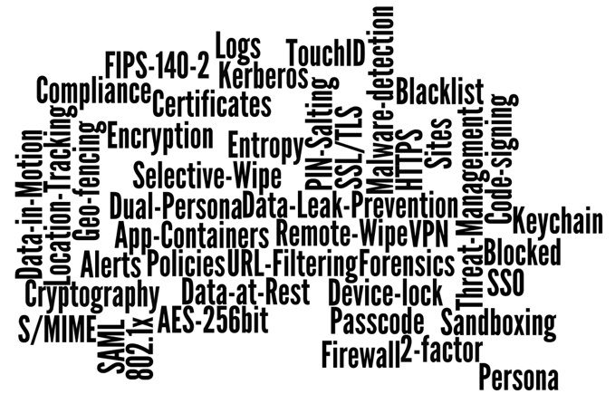
Trusted Workplace™ Security technology
Did you know?
MaaS360 has over 1,175 different security policy settings and controls

